Slide 1
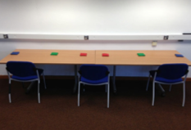
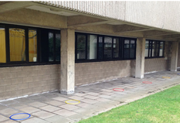
Table task
Table task
Experiment 1A
Throwing task
Small talk
Table task
Experiment 1B
Verbal FDD problem
Throwing task
Arithmetic problems
Throwing task
Experiment 1C
Throwing task
Table task
Throwing task
Sodoku

